Slide 2
PDF/MFD multi
PFD
Pages
GOTO
FPL
CLR
RK
MFD
MENU
PROC
ENTER
RADIO
Radio
COM FREQ
SWAP
Radio
SWAP
NAV FREQ
COM
A
MRKR MUTE
COM1
COM2
COM3
NAV1
NAV2
VOLUME/SQ
O
SENS
MIC1
MIC2
MIC3
DME
ADF
M
AP
HDG
APR
NAV
AP
FD
YD
HDG
BC
CRS1
BANK
AT ?
CRS2/ BARO
ALT
ALT
VS
FLC
SPD
IAS
VNV
LIGHT
DIMM
LIGHT

Slide 3
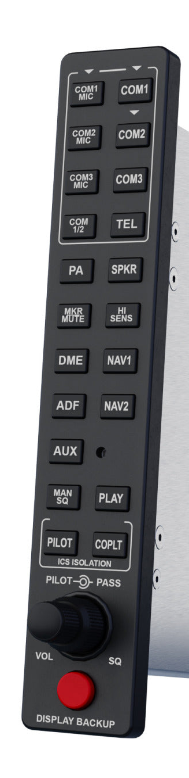
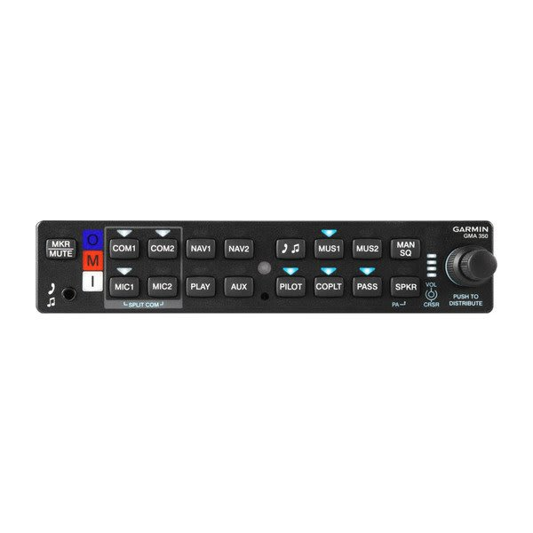

Slide 4
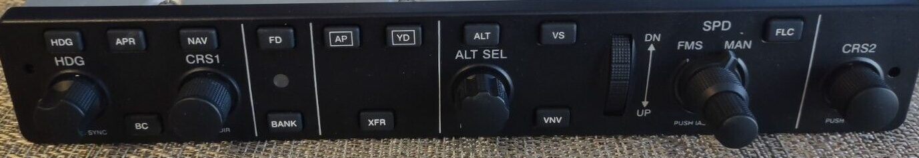
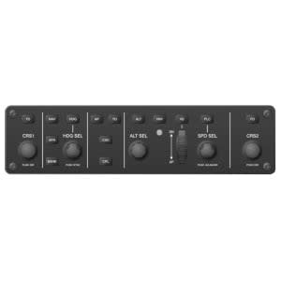
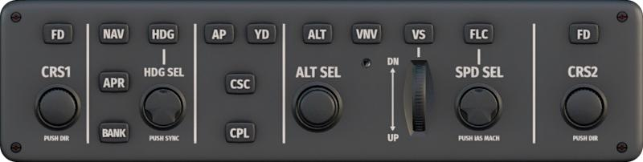
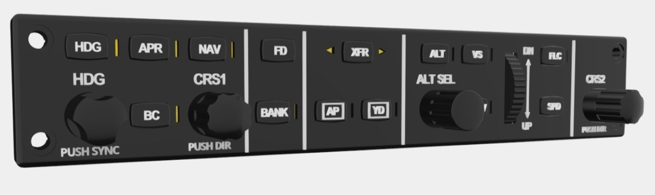
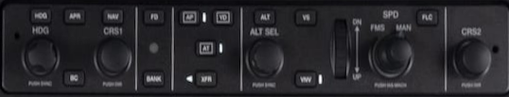
To scale
AP
HDG
APR
NAV
AP
FD
YD
HDG
BC
CRS1
BANK
AT ?
CRS2/ BARO
ALT
ALT
VS
FLC
SPD
IAS
VNV

